Slide 1
Relating the principles…a quick case study of BCU
Notes:
Apologies for any repetition – familiar faces
Retrospective look back at how we approach student partnership – whistle stop – much more detail available – ELGAN HUGHES

Slide 2
We didn’t have any principles!
NSS Feedback
Fielding (2001) ‘Students as radical agents of change’
Notes:
No real set of principle per se
NSS feedback – Learning Communities, Student Voice, Relationship with Staff, Assessment & Feedback
Michael Fielding’s paper – List of conditions that support change agency
SU and Institutional relationship – key driver for our change in culture – ‘them and us culture’ embodied the relationship of staff and students

Slide 3
…but if we were looking for some…
…these would be great!
Notes:
We started off very much in the L&T domain matching students and staff within projects to develop learning communities, pedagogical development and identifying students as key vehicles for change
But this has now broadened into wider student engagement activity including joint Welcome Week activity, induction & orientation, NSS promotion, developing a sports strategy, Learning and Teaching Awards, a myriad of working groups and establishing students and the student voice at the heart of what we do

Slide 4
1 – Strategic / Philosophical Alliances
E.g.. Joint strategic plans / Shared Values / Ability to challenge
2 – People / Operational Alliances
E.g.. Shared roles / Co- Project Management and Ownership
3 – Project / Front line Alliances
E.g.. Joint projects
Notes:
Our strategic approach – in hindsight!

Slide 5
VC – University
SU – Executive
Committee
Committee
Committee
Committee
Committee
Committee
Committee
Staff
Students
Notes:
Our strategic approach – in hindsight!

Slide 6
VC – University
SU – Executive
S.U.
Staff
Students
Notes:
Our strategic approach – in hindsight!

Slide 7
Learning & Teaching
RoLEx working groups
Student Academic Partners
Student Academic Mentors
Student Teaching Expectations
HEA What Works?
Extra Mile Awards

Slide 8
QA & QE Processes
NSS Enhancement Teams
SAP Projects
Student Academic Leaders / Feedback Forums
School Academic Board
Student Success Advisors

Slide 9
Decision Making, Governance & Strategy
Strategic Vision 2020 – ‘Partners for Success’
Student Academic Leaders
School Representatives
Student / Graduate Interns
Student Feedback Forums
UK Student Engagement Survey

Slide 10
Students are more than students
Mentor
Partner
Collaborator
Expert
Change Agent
Employee
Evaluator / Reviewer
Representative
Leader (Academic / non- Academic)
Notes:
Create a framework for staff and students to operate within
Start small
Balance of doing and thinking
Trust your students

Slide 11
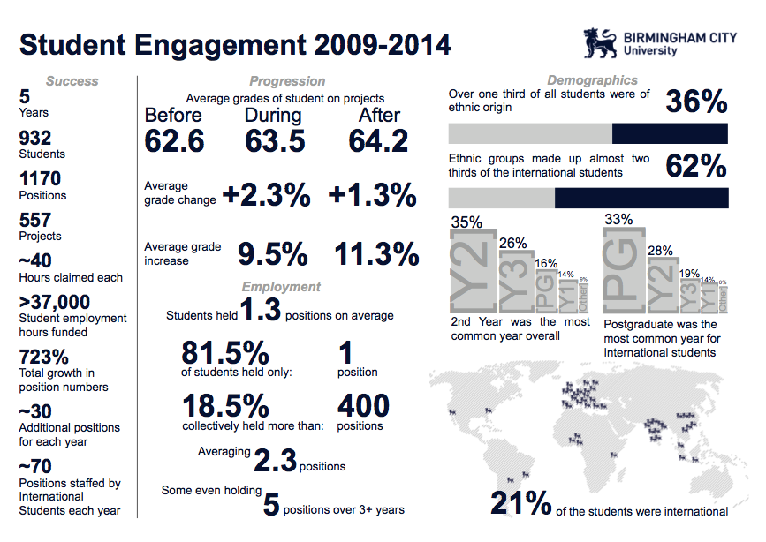

Slide 12
Society
Course / Student Colleagues
Module
Your University Experience
University
School / Faculty
Local Community
Notes:
Students as change agents in many spheres of influence

