Slide 1
Scaling up and embedding student-staff partnership working
Duncan McKenna & Aisha Benachour

Slide 2
About US
University of Greenwich
Duncan – Student Partnership Coordinator
Aisha – Student Scholar with one of our projects
Multiple projects, macro overview

Slide 3
Our Projects
Programme level A&F research project
Qual. & quant data – staff & students
Students involved as: co-researchers, supporters of change, conduits of info to student body
Student-led, institution-wide, cultural transformation to support development of graduate attributes
Viewpoint Cards - “Defin[ing] core student capabilities, attributes and development frameworks for student innovation and change”

Slide 4
Cascade Model
Model developed across various projects
Main focus
General benefits and lessons learned

Slide 5
Escalating engagement due to interactions with partnership work
Cascade Model
‘Trickle-down’ engagement
Students working in direct partnership (Scholars/Change Agents)
Students working with scholars/change agents as assistants
‘Normal’ Students who interact with activities and processes and engaged in and outside the classroom
Interactions with student body
COHORT

Slide 6
Why is this model successful at scaling-up and embedding partnership?
Student ownership and responsibility
Increased student-to-student interactions
A broader cross-section of the cohort is reached than with staff-only interaction - organic
Students can become involved at any level
Allows suitable flexibility in working roles

Slide 7
Why is this model successful at scaling-up and embedding partnership?
Intrinsic Value – student insight into richer and broader learning context
Increases employability due to breadth of work
Creates better connections within cohort and university

Slide 8
Successful tactics for scaling up and embedding
Draw out and stimulate intrinsic motivations

Slide 9
Successful tactics for scaling up and embedding
Try to create an organic, rolling process of students passing on skills to other students

Slide 10
Successful tactics for scaling up and embedding
Always be willing to adapt the model

Slide 11
Student Viewpoint
Projects: Based on the Greenwich Graduate Attributes
Staff Interviews and Blogs (Scholarship and Autonomy)
Student Stories and Vlogs (Creativity and Enterprise)
Cultural Awareness Event (Cross Cultural and International Awareness)

Slide 12
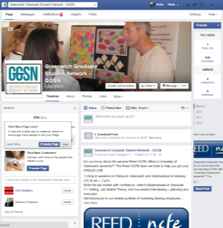
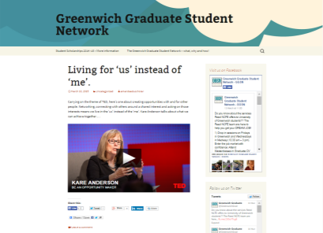

Slide 13
Contact
d.mckenna@gre.ac.uk
Educational Development Unit

Slide 14
Image Attributions
All images were used under a Creative Commons Licence from Flickr users, with thanks.
Slide 1. Nikos Koutoulas
2. Jamie McCaffrey
3. Somedriftwood
4. Ciprean Tadea
6-7. acearchie
8-10. John Morgan
11. Robert Korner

